Slide 1
Health Care System

Slide 2
Intorduction
Providing reliable and effective medical facilities to the people suffering from various ails, which might be as results of climatic change, higher workload than optimum level, emotional trauma stress, accidents among others.
Some of this ailment require faster attention term as emergency, so it’s important to embrace on the technological features of bring services closer to the patients and everyone who needs the service

Slide 3
Motivation and system features
It’s important for all the hospitals to keep tracks of all the daily process and activities which includes records of the patients, nurses, doctors ,ward assistance and other professionals that help in hospital services.
They ensure the hospital activities run smoothly and successful.
Facilitating all this activities in hospitals such as keeping records of all the activities and process on paper manually its a very cumbersome ,tiresome and error pones.
Also, its very inefficient , less effective and times consuming activities considering the increasing population and the number count of people attending the hospital.

Slide 4
Continue…
Also the number of people calling to ask if certain medicine are available at hospital, this needs to be addresses to solve this problem to let the people enjoy this service at their homestead on their smartphones and wait for delivery to their door step.
Working on manually ways not economical to the hospital management and also technically feasible maintenance of all the hospital records.
Also keeping tracking of the patients records from the reception till issued medication after confirming from the insurance company if the card has some cash for the activity to be completed.
All this activities are cannot be done on the manually thus this project aims to developed automated version of the old system of all hospital activities.

Slide 5
Continue…
The system will be an online based platform which can be accessed by anyone by just registering on the website as a member and he or she continues to enjoy all the activities.
The online based website will not enable provision of service in efficient way but also provide best securities to data at every stage of user system interaction and enough storage capacity on cloud to keep all the system backups.
Lastly but not least the online based system will help the grant agencies to check on the progress of various activities also the issuance companies will have simple ways to integrate their payment methods ion the website platforms.

Slide 6
Continues…
Also some few features will be integrated in the website platform which includes ;
sensed data this are data generated by sensors on real time based on the patients analytical
Record of analytic data
Medical records
Medical service data
Insurance claims
Insurance policies.

Slide 7
Analysis plan
Provide patients medical records to keep all system pioneers up to date.
Scheduling the appointments of patients, so new clients would know if their any available appointment.

Slide 8
Analysis plan
The website platform should handle the test reports for the patients conducted in the labs through the sensors machines and transmitted to patient database.
The information of the patients should be kept up to date and their record should be kept in the system for future references.

Slide 9
System architectures and tools
System architecture involves several tools ,languages and the platform for hosting the site.
Tools includes the IoT device which are programmed to send real data to the computer system through the website platforms.

Slide 10
System architectures and tools
The system will be developed using ;
PHP programming language with laravel frameworks
Java Script for validation of the activities.
The platform which the website will be hosted in is the Amazon Web Services
which support cloud storage and other facilities.

Slide 11
Meeting plan
Task Name | Feb | Mar |  |  |  | Apr |  |  | May
 | Week1 | Week1 | Week2 | Week3 | Week4 | Week1 | Week2 | Week3 | Week4 | Week1
1- Hosting domain (Picking Cloud platform). | Abbas, Omar, Ali
2- Create a website (create pages). |  |  | Abbas, Omar
3- Design images. |  |  | Ali
3- Developing the website (Coding) |  |  | Abbas, Omar, Ali
4- APIs implementation (calling APIs). |  |  |  | Omar
5- Testing web (9 Major tests). |  |  |  |  | Ali, Omar, Ali
Φυνχτιοναλιτψ Τεστινγ |  |  |  |  | Ali
Τεστ Φορμσ |  |  |  |  | Abbas
Test HTML and CSS |  |  |  |  | Abbas
Usability testing |  |  |  |  | Ali
Ιντερφαχε Τεστινγ |  |  |  |  | Omar
Δαταβασε Τεστινγ |  |  |  |  | Omar
Βροωσερ Χομπατιβιλιτψ Τεστ. |  |  |  |  | Abbas
Performance Testing: |  |  |  |  | Abbas, Ali
Security testing (SSL & Payments): |  |  |  |  |  |  | Omar, Ali, Abbas
6- Publishing the website. (Finalize) |  |  |  |  |  |  |  |  | Ali, Omar, Ali

Slide 12
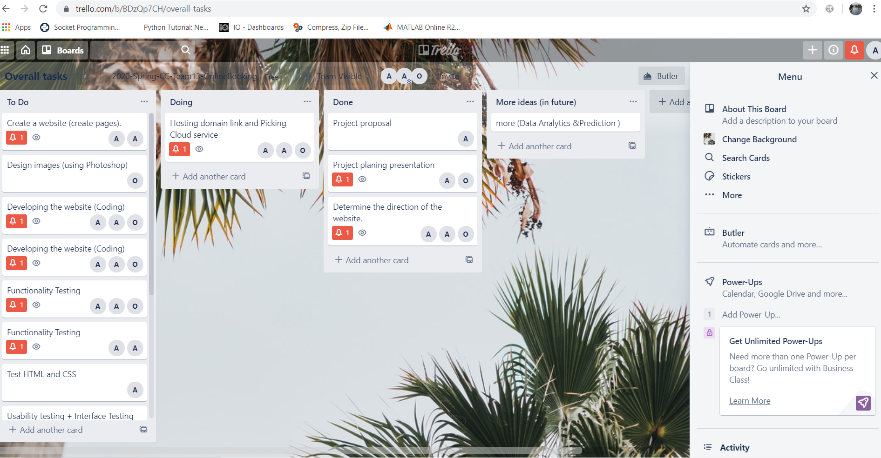
Trello Board and GitHub link
https://github.com/Alshaikh1abbas/CS5525-CC

